Slide 1
Command
Behavioral Design Pattern

Slide 2
Design
Object per command
Command Interface
Execute Method
‘Un-execute’ Method ( Optional method )
Command, Invoker, Concrete Command, Receiver
Examples: Java.lang.Runnable

Slide 3
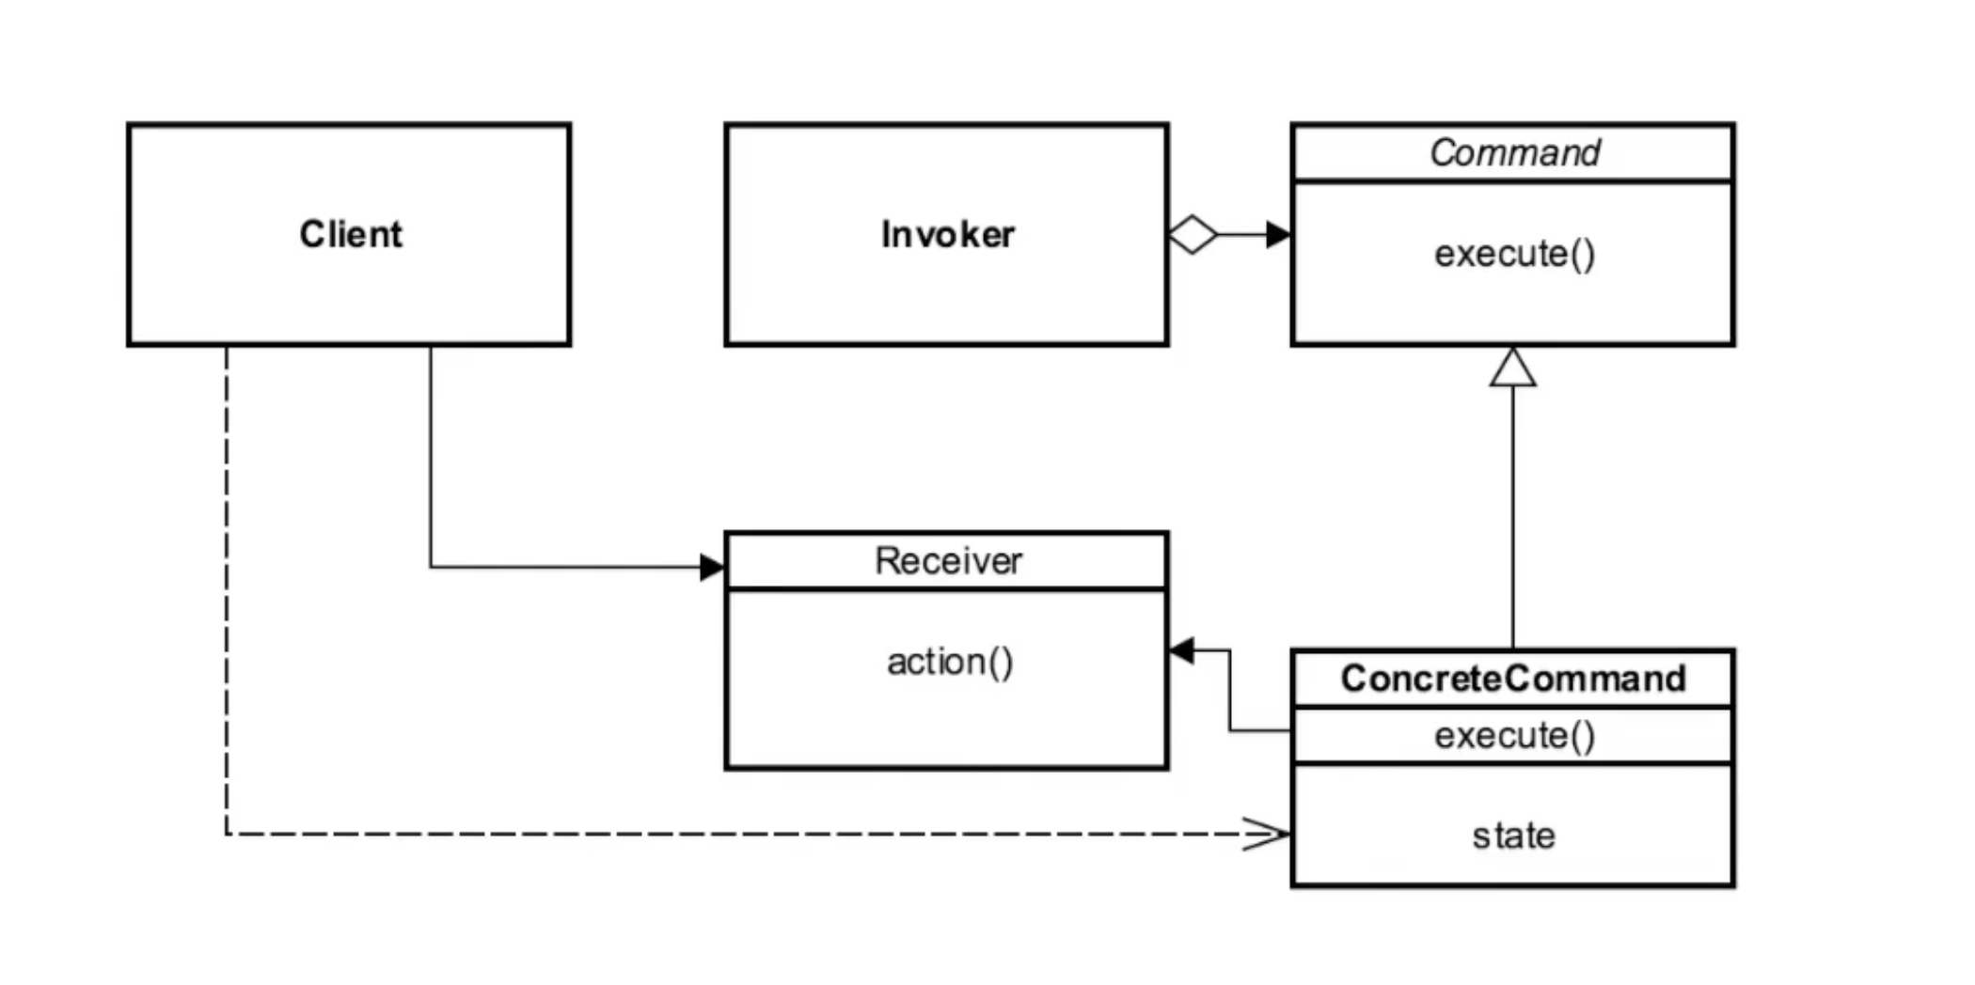
UML Diagram

Slide 4
Example
We have a receiver class Light, which have two methods turn on and turn off
Instead of using these methods, we will use concrete command instances to do so

Slide 5
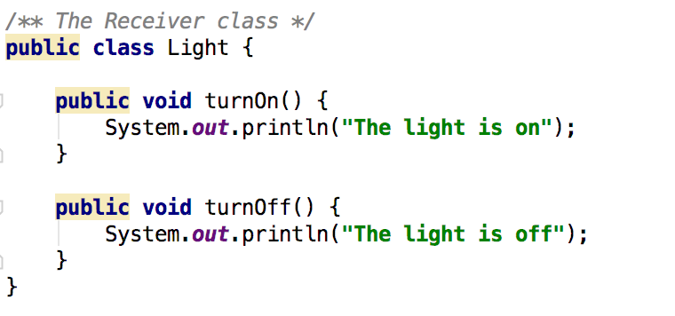

Slide 6
Example (Continued)
Next we have a Command interface in which there is execute() function, which executes the command
Two concrete commands FlipUpCommand and FlipDownCommand implements Command interface

Slide 7
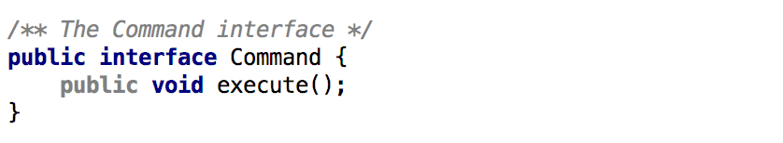
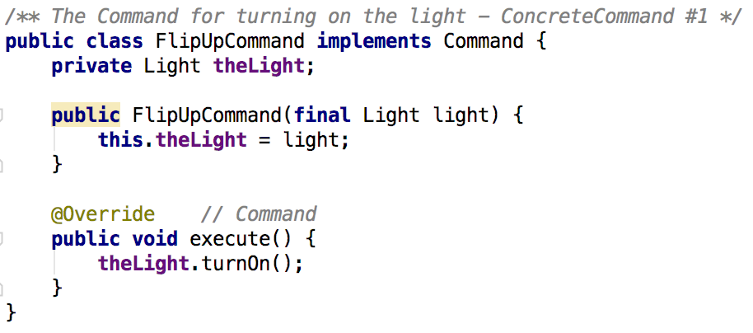
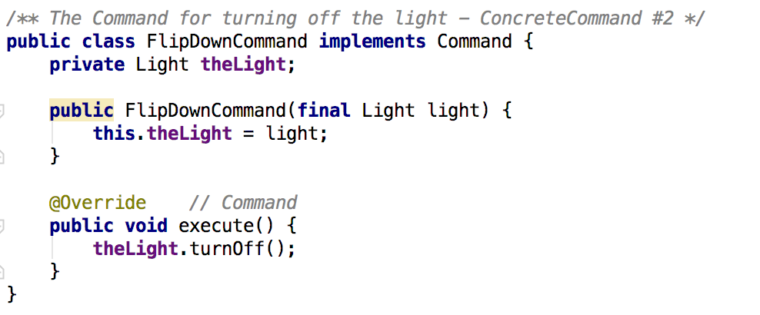

Slide 8
Example (Continued)
We have invoker class, Switch class in this case
It has storeAndExecute() function, which keeps the list of commands which are already been issued by client

Slide 9
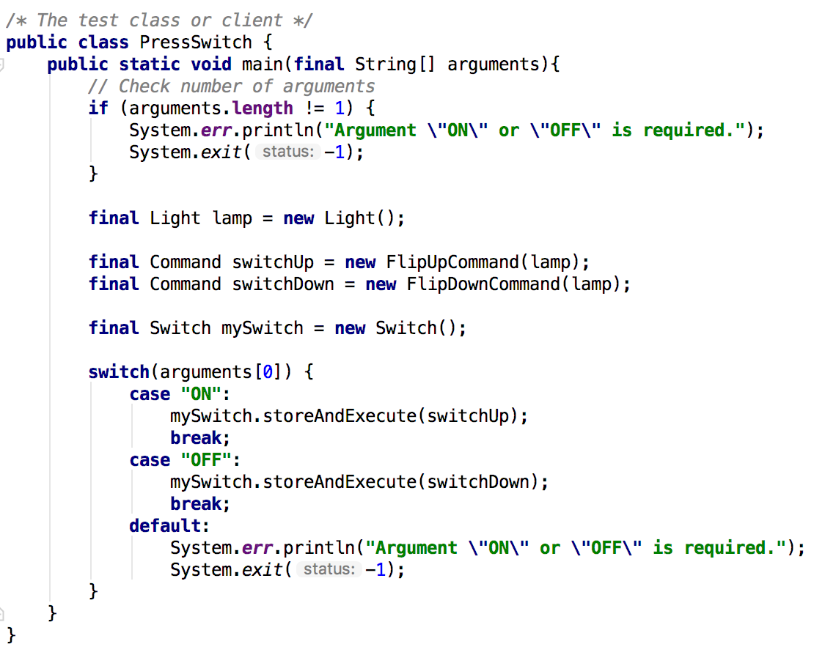
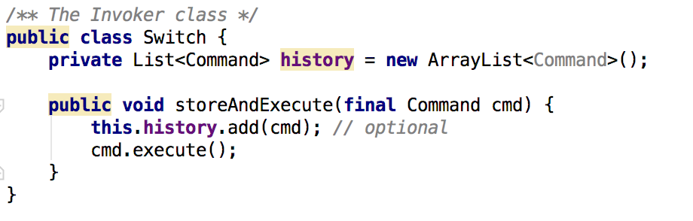

Slide 10
Example (Continued)
Client class creates instances of Light class, invoker, and concrete commands
Switch class take commands as parameter and commands take light instances as parameters

Slide 11
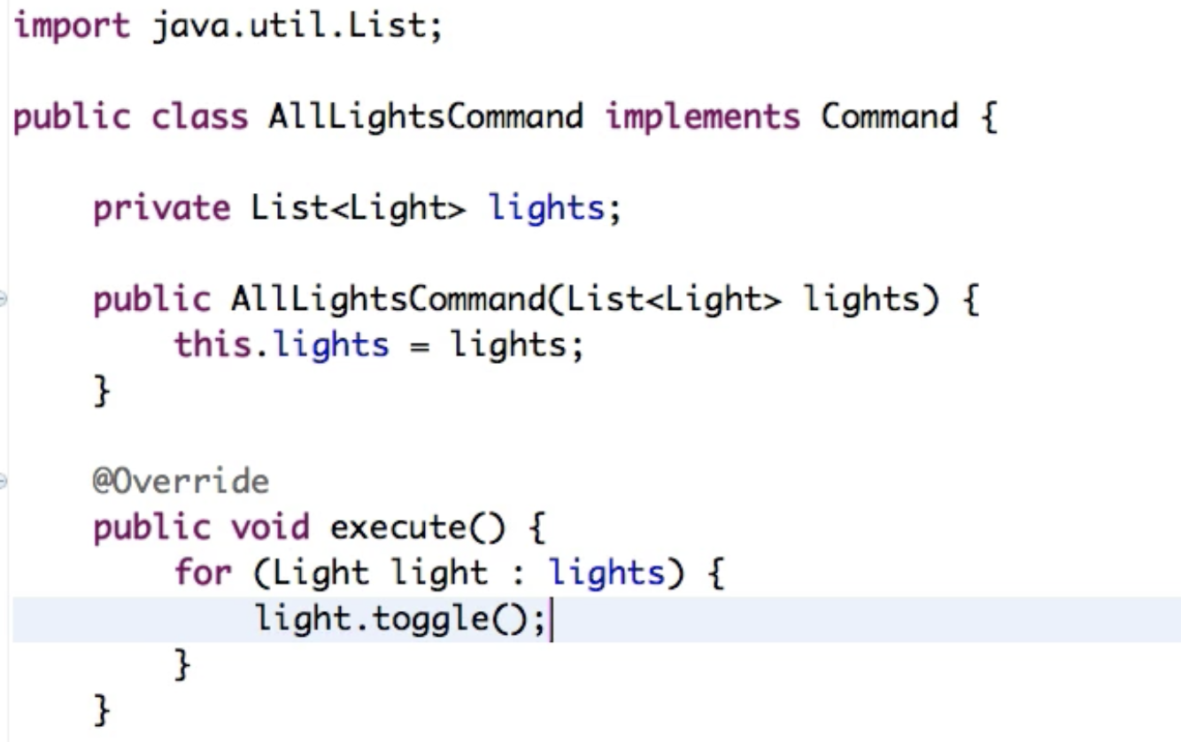
What we have achieved?
Usually commands are methods of instances, but here Command itself is an object
Object Oriented callbacks
What if we have a list of instances of light?
We can make a list of all those light instances and pass it to a new concrete command
That concrete command can now implement execute() for every light instance

Slide 12
What we have achieved? (Continued)
The object that invokes the operation is decoupled from the object that knows how to perform the action. (The "invoker" is decoupled from the "receiver".) As a result, that action can easily be changed without requiring a corresponding change in the invoker.

Slide 13
Cons
Increase in the number of classes for each individual command

Slide 14
Thank You

